Slide 1
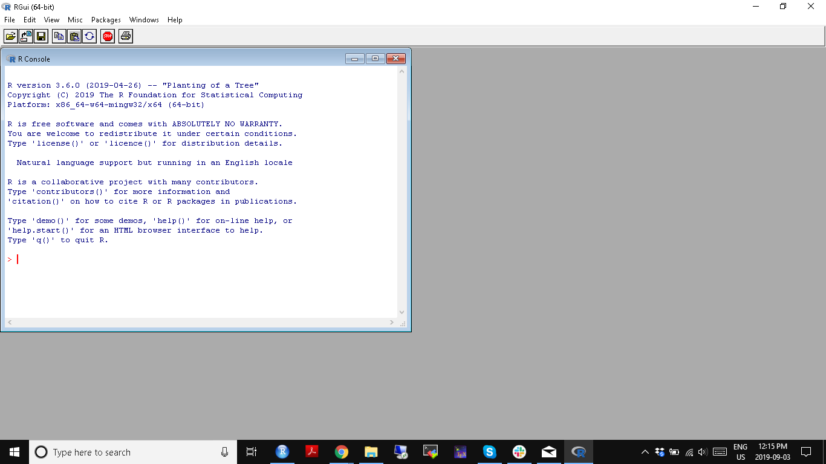

Slide 2
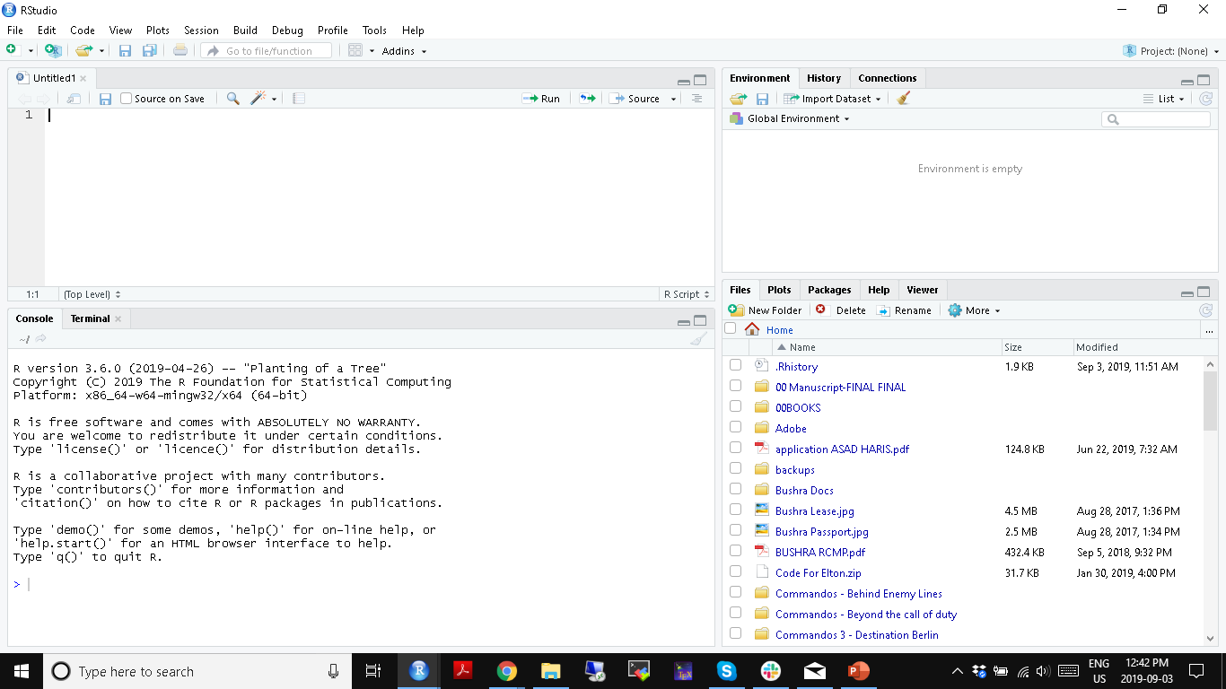

Slide 3
The R code editor for writing scripts
A script is a text file with extension .r

Slide 4
The interactive R console
Can be used for line-by-line code
All code executed in editor will also show up here

Slide 5
Displays all variables/objects in the working environment

Slide 6
Displays files in working directory

Slide 7
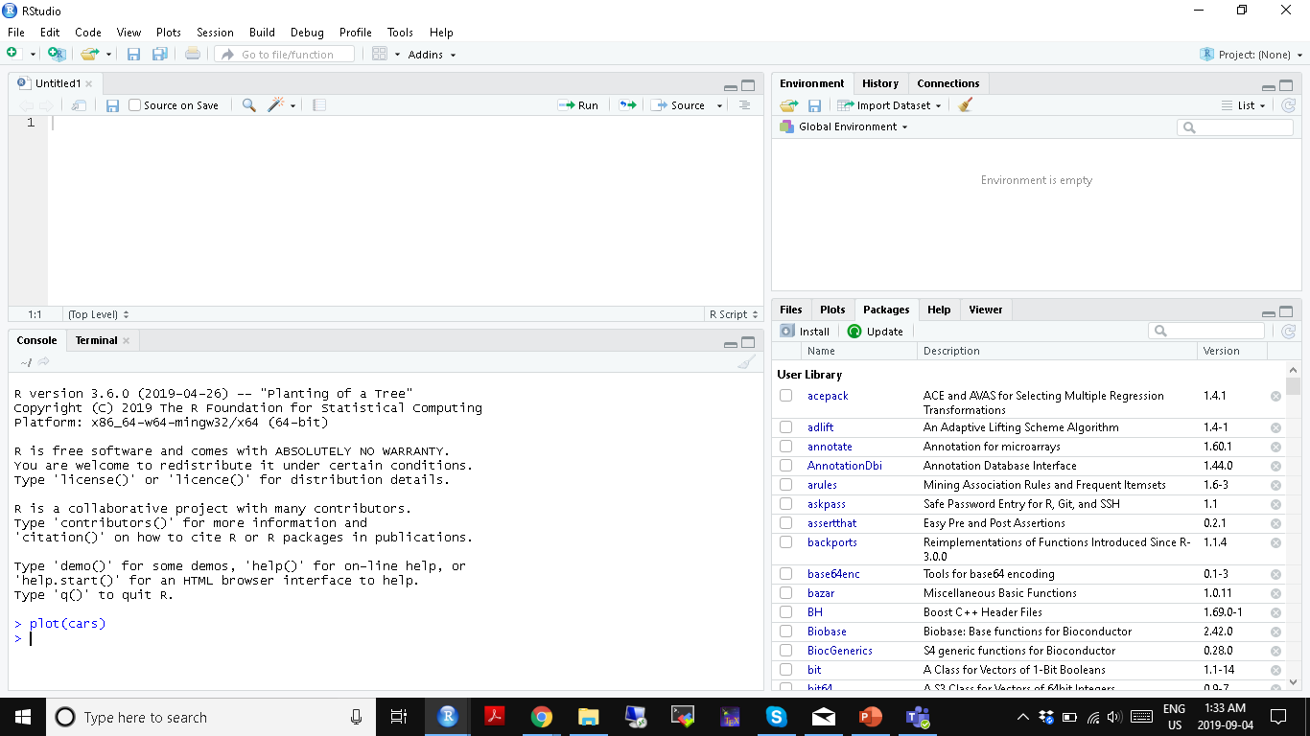
Installed or available packages list is displayed here

Slide 8
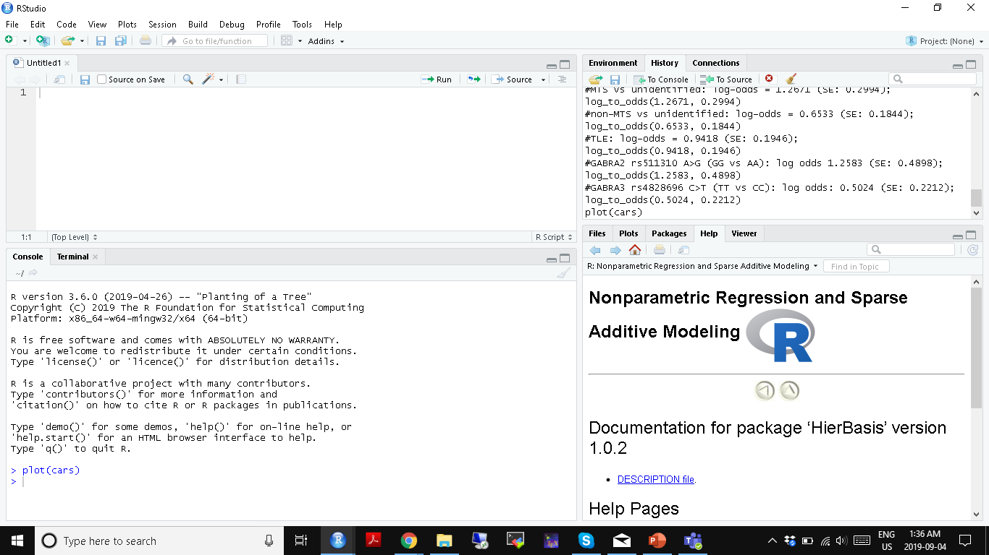
History of all code that is run in the console. Including R scripts.
Help files when called from console

